Slide 1
5.05 Apply Looping Structures
Computer Programming I
Notes:
This PowerPoint is broken down into sections for VB and C# for ease of showing to students.

Slide 2
Objective/Essential Standard
Essential Standard 5.00 Apply Programming and Conditional Logic (23%)
Indicator 5.05 Apply Looping Statements. (8%)

Slide 3
Getting Input from an InputBox
Computer programming 1

Slide 4
Getting Input from the User
Sometimes we need input from the user.
We already learned how to do this using a text box.
There is another method: the input box.
The input box is a dialog box that pops up and prompts the user for input. The program stops and waits until the user inputs data or cancels the box.

Slide 5
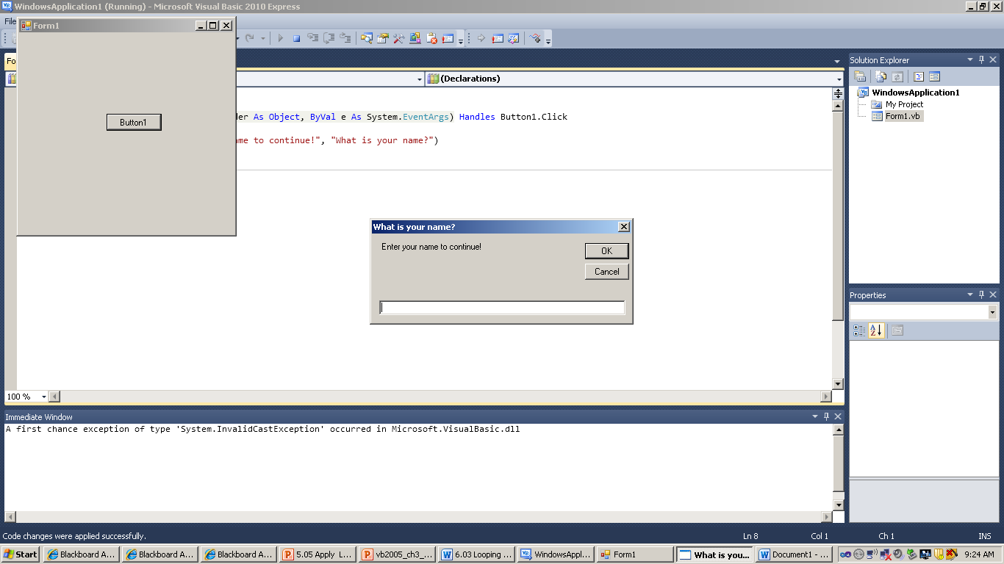
Input Boxes – Syntax & Example
Syntax: StringVariable = InputBox (prompt, title)
The prompt and title can be string literals or string variables.
Example: strName= InputBox(“Enter your name to continue!:”, “What is your name?”)
The program stops executing until the user chooses the OK or Cancel buttons. Then the next line of code executes.

Slide 6
Input Boxes - Uses
Repeated Data Input: Input boxes can be placed within a loop to provide repeated input until the user ends the loop.
Enter scores (Enter -1 to Quit)
A variable number
Enter 10 scores
A fixed number
Data Validation: Input Boxes can check to see if the user actually keyed something.
Code uses the NOTHING keyword and an IF statement with the InputBox. (Example follows).

Slide 7
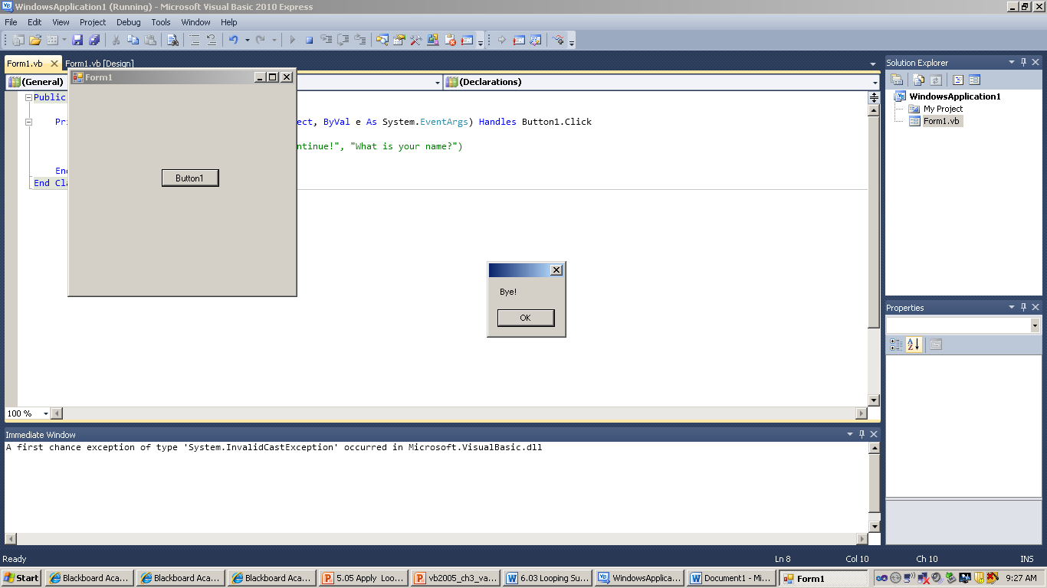
Input Boxes – “Empty” Data Validation
If strName = Nothing Then
strName= InputBox(“Enter your name to continue!:”, “What is your name?”)
End If
If strName = Nothing Then
Messagebox.Show(“Bye!”)
Application.Exit()
End If
Notes:
Application.Exit() Exit is a method of the application function that will terminate the program. So Application.Exit() can be used anywhere to quit (terminate) the program.

Slide 8
Special Variables with Loops

Slide 9
Counter Variables
When dealing with loops you also may use a counter variable to determine the number of times a loop executes.
This type of counter you can declare Dim instead of Static outside of the loop.
This variable (normally of integer data type) helps the computer know where it is in the loop.
The most common name for a counter variable is i. Next comes j, then k, and so on.
Notes:
Trivia: This naming convention dates from the days of FORTRAN when i,j,k were integers by default so it became common practice to use them as counter variables.

Slide 10
Increment the Counter
After each run through the loop we want to add (or subtract) some constant number (usually 1) from the counter variable.
Examples
i = i + 1 or i+=1
i = i - 1 or i-=1
i+=2 or i-=2
Notes:
Note, this is NOT used in a For or Foreach loop as we will discuss shortly. The variable increments is written directly in the loop statement.
Note: The next sections are broken down by language- only show the one that is for your class.

Slide 11
Accumulator Variables
Similar to a counter, except the value that updates the accumulator changes
A variable storing a number that is incremented by a changing value.
Forms:
accumulator = accumulator + value
accumulator += value
Example: dblCost = dblCost + newSale
Useful for keeping a running total

Slide 12
Looping Structures
Visual basic

Slide 13
Repeated Actions
Have you ever performed the same action over and over?
For example: As long as it rains I am going to sing the same song. When the song finishes I am going to start over again.
Programmers can code repeated actions into their programs. This is called a loop.
Each time the loop runs is called an iteration.

Slide 14
Types of Loops
These are the four types of loops.
Do While …Loop
Do……Loop While
For…Next
For Each…Next
Covered later

Slide 15
Pretest and Posttest
When dealing with loops there are two different ways to test a condition.
Pretest
Test the condition BEFORE the loop runs. If the condition is false the loop will not execute.
A pretest loop only executes if the condition is true for at least one time.
Posttest
Run the loop one time then test the condition- if the condition is false the loop will then terminate.
A posttest loop will ALWAYS execute at least one time.
Notes:
A posttest loop will ALWAYS execute at least one time. A pretest loop only executes if the condition is true for at least one time.

Slide 16
Endless Loop
A logic error known as the endless or infinite loop occurs when the programmer forgets to increment the counter variable.
A loop is endless when it is always true - so it will run forever until the computer crashes (or modern operating systems/web browsers will alert the end user so they can terminate the program). Dim x As Integer = 5 Do While (x < 10) ‘always true x -= 1 Loop
Notes:
Basic example of a endless loop- since i is not incremented in the loop its value is always zero. So the loop is always true and runs over and over until the computer runs out of RAM. Notice the i+=1 statement is missing. Application question: After showing the types of loops- what type of loop is almost impossible to create an endless loop with if properly formatted? (Answer: for loop- since the increment is in the for statement itself)

Slide 17
Do While ….. Loop
PreTest

Slide 18
Do While…Loop
Syntax
Do While condition
Statements
Loop
This form executes only if condition is true, therefore if condition is false, the loop does not execute.
This is a pre-test loop.
Checks the
condition first

Slide 19
Do While…Loop
Example
sum = 20 Do While sum < 10 sum += 2 Loop The statement does not iterate at all because sum is initially greater than 10.
Is sum less than 10?
No, so the loop does not “iterate”
Notes:
This simple loops runs 50 times and adds up all numbers 1 to 50. This a pretest loop.

Slide 20
Do…Loop While
PostTest

Slide 21
Do…Loop While
The looping structure that evaluates a condition after executing a loop once.
Syntax
Do
Statements
Loop While condition
* Statements is the loop and is executed at least once.
* Condition is a Boolean expression used to determine if the loop is to be repeated.
condition is true → repeats
Checks the condition after it has looped at least once.

Slide 22
Do…Loop While Example exit using variable Sum
The looping structure that executes a set of statements as long as a condition is true.
The condition is a Boolean expression.
Evaluates to T or F
Executes at least once.
The loop below iterates (repeats) while sum is less than 10: sum = 0; Do sum =sum + 2 Loop While sum < 10
Is sum less than 10?
No, stop.
Yes, continue to loop

Slide 23
Do…Loop While Example
Write a program that adds all numbers up from 1 to 50.
Dim i As Integer = 0
Do
intResult = intResult + i ‘accumulator
i += 1 ‘Updates i
Loop While (i <= 50)
lblResult.Text = intResult.ToString()
Notes:
This simple loops runs 50 times and adds up all numbers 1 to 50. This is a posttest loop.

Slide 24
Controlling Do Loop Exit Programmer Controlled Variable
You must set up logic to exit a Do Loop. 2 Methods.
Method 1: Programmer Controlled Variable (often a counter)
Dim a variable. ex: Dim intCount As Integer
Before the Loop, set variable to a starting value. intCount = 1
Inside the Loop, update the variable. ex: intCount = inCount + 1
Loop Question must use variable. ex: “While inCount < 5”.
This method depends on logic written into the code, there is no user input used.

Slide 25
Do While …Loop Example exit using variable i
Add all even numbers 1 to 25 - skip all odd numbers.
Dim i As Integer = 0
Dim intResult As Integer = 0
Do while i < 25
intResult = intResult + i ‘ updates intResult by i
i += 2 ‘ increases i by 2
Loop
Accumulator
Updates i
Notes:
If not teaching C# skip the next section.

Slide 26
Controlling Do Loop Exit - Flags
Method 2: Flags Keyed by User
Before the Loop, read data from user (use inputbox) strInput = INPUTBOX(“Enter name - key STOP to end”.
DoWhile question asks “ strInput not equal to flag” at top of loop. If any “good” data is entered “True”, you enter the loop and do work. If the flag is entered, “False” happens and you jump to LOOP to end.
DOWHILE strInput <> “STOP”
Inside loop after all work is done, repeat line #1 (Read another input). This allows the user to put in data 2, 3, 4 and then “STOP” to end the loop. strInput = INPUTBOX(“Enter name - key STOP to end”.

Slide 27
Using Do While to Validate Input – two InputBoxes
Dim intNum As Integer = -1
Dim strInputNum As String = “”
strInputNum = InputBox("Enter a Number between 1 & 10", "Number")
Do While ((Convert.ToInt32(strInputNum) < 1) Or
(Convert.ToInt32 (strInputNum) > 10) Or
strInput = nothing)
strInputNum = InputBox("Enter a Number between 1 & 10", "Number")
Loop
MessageBox.Show("You entered a number between 1 & 10. Your number was " & strInputNum)

Slide 28
Using Do..Loop While to Validate Input - one InputBox
Dim intNum As Integer = -1
Dim strInputNum As String = “”
Do
MessageBox.Show("Enter a Number between 1 & 10")
strInputNum = InputBox("Enter a Number between 1 & 10", "Number")
Loop While (strInputNum = Nothing Or (Convert.ToInt32(strInputNum)< 1 Or Convert.ToInt32 (strInputNum) > 10))
MessageBox.Show("You entered a number between 1 & 10. Your number was " & strInputNum)

Slide 29
Special Variables with Loops

Slide 30
Using Flags
Flag or Sentinel
Vocabulary Concept – set up special way to exit a loop
A condition used to signify that a loop should stop executing.
Usually declared as a Const (constant)
Example
Const strFLAG As String = “Quit”
strTempInput = InputBox(“Enter a positive number (Quit to stop)”)
Do While strTempInput <> Nothing Or strTempInput <> strFLAG
Statements
strTempInput = InputBox(“Enter a positive number (Quit to stop)”)
Loop

Slide 31
Example: Using A Flag, Counters & Accumulators
Const strPROMPT As String = “Enter Number, use “STOP” to end”
Const strTITLE As String = “Running Totals”
’Input once before loop
strTempNum = InputBox (strPROMPT, strTITLE)
Do While strTempNum <> “STOP”
intNum = Convert.ToInt32(strTempNum)
numcounter += 1 ’Counts iterations – Counter
intSum += intNum ’Running total - Accumulator
’Repeated input for each iteration
strTempNum = InputBox (strPROMPT, strTITLE)
Loop

Slide 32
For Next Loop
Visual Basic

Slide 33
The For … Next Statement
A looping structure that executes a set of statements a fixed number of times.
Executes until counter is reached.
The counter is automatically incremented by 1.
Syntax:
For counter = start To end
Statements
Next counter
** counter, start and end are Integer variables.

Slide 34
How the For…Next Works
You create an integer counter to use after the keyword FOR.
The first time the For line executes, your counter is set to whatever is after the “=”. It does NOT reset each time the loop repeats.
Each time “Next” is executed, the counter is updated by 1 (default value is 1)
The condition is tested on the FOR line
The condition is still true when counter reaches the value after the “TO”. (Loop still executes)
When the condition is tested false, execution jumps to statement after the NEXT.
Remember, counter is updated to false value and holds that value when you exit the loop.

Slide 35
For…Next Example
The loop below executes until intNum is equal to 5, by checking one last time (it is no longer true), jumps to Next and exits the loop. Dim intNum As Integer For intNum = 1 To 4 ‘accumulator intTotal = intTotal + intNum Next intNum
The variable counter “intNum” holds a 5 after the loop ends, but the code inside only executed four times.
intNum | intTotal
1 | 1
2 | 3
3 | 6
4 | 10
5

Slide 36
For…Next – Internal Counter
You may create the counter variable (intCount) in the For line by using the optional As Integer keywords, rather than using a Dim command before the loop.
The lifetime of the variable counter created this way is the lifetime of the loop. (When you exit the loop, the variable counter no longer exists).
For intCount As Integer = 0 To 4 intTotal = intTotal + intCount Next intCount
intCount is only in scope in the loop
The last value of intCount is 4
intCount | intTotal
0 | 0
1 | 1
2 | 3
3 | 6
4 | 10

Slide 37
The For … Next Statement with Step
Step
Changes the way the counter is incremented.
Can be positive or negative
Syntax
For counter = start To end Step stepnum
Statements
Next counter

Slide 38
For…Next…Step Example
The step integer can be a negative number to tell the compiler to decrement the counter.
Make sure your start is the high number, the end is the low number.
For intY = 5 To 1 Step -1
MessageBox.Show("Counting Down " & intY.ToString())
Next intY

Slide 39
For…Next…Step Example
Add all even numbers 1 to 250 - skip all odd numbers.
For i as Integer = 0 to 250 Step 2
intResult = intResult + i
Next i
lblResult.Text = intResult.ToString()
Counting by 2’s instead of 1’s.
Notes:
Step is used to change how the counter variable increments. This ONLY works in For loops.

Slide 40
So What Loop to Use?
Use a For…Next loop when you know how many times the loop will run or are getting it as input.
This can be in the form of a number or a variable.
The condition will automatically turn false.
Use a While loop (or Do While) when your logic controls the condition becoming false.
If you do not make the condition false, an infinite loop results
Two possible ways to control a While: Use a variable that changes or a flag input from the user.
Notes:
Use a For…Next loop when you know how many times the loop will run. This can be in the form of constants or variables. You might not know the numbers, but they can be input right before the For…Next runs, ie you can ask the user for this. In a FOR…Next loop, False happens automatically. It is based on the setup of the For line and the automatic incrementing of the counter variable when the Next line executes (default without STEP adds 1 to counter on Next line).
Use a While loop (or Do While) when your logic TURNs the condition false. This can be a variable used in the condition that changes based on the program logic, or a Flag entered by the user. In a While loop, logic must create the “False” condition. If you don’t make it happen, an infinite loop results.

Slide 41
Programming Assignment
Write a program has 3 buttons - one for each loop type. (Do, While, and For)
Each loop should add all even numbers one through fifty and write the result to a label.
The result should be 650.
Notes:
Sample code for both languages is in the slide notes document.

Slide 42
Solution
Private Sub btnFor_Click(ByVal sender As System.Object, ByVal e As System.EventArgs) Handles btnFor.Click
Dim intSum As Integer
For intNum As Integer = 0 To 50 Step 2
intSum += intNum ‘accumulator/running total
Next
Me.lblForAnswer.Text = intSum.ToString
End Sub
Private Sub btnDo_Click(ByVal sender As System.Object, ByVal e As System.EventArgs) Handles btnDo.Click
Dim intNum, intSum As Integer
Do
intSum += intNum ‘accumulator/running total
intNum += 2 ‘update intNum
Loop While (intNum <= 50)
Me.lblDoAnswer.Text = intSum.ToString
End Sub
Private Sub btnDoWhile_Click(ByVal sender As System.Object, ByVal e As System.EventArgs) Handles btnDoWhile.Click
Dim intNum, intSum As Integer
Do While (intNum <= 50)
intSum += intNum ‘accumulator/running total
intNum += 2 ‘update intNum
Loop
Me.lblDoWhileAnswer.Text = intSum.ToString End Sub

Slide 43
Wrap Up
This lesson introduced the different types of loops and why loops are so useful in programming.
For more information http://msdn.microsoft.com/en-us/library/ezk76t25.aspx

